Slide 1

Telecom Churn Prediction
Predicting customer churn using machine learning
Presented by:
Vrushali Oak
Data Scientist

Slide 2

Understanding Churn
Customer churn refers where clients discontinue their service.
Understanding churn is essential as it impacts revenue and growth. Identifying the reasons behind customer dissatisfaction helps businesses improve services and develop effective retention strategies.

Slide 3
Business Problem
  Customer churn leads to significant revenue loss in telecom
  Retaining existing customers is cheaper than acquiring new ones
  Objective: Predict customers likely to churn so retention teams can act early

Slide 4
Dataset Overview
  25,000 customers, 36 features
  Includes numerical, binary, and categorical variables
  Target variable: is_churn (1 = churned, 0 = retained)
  Churn distribution:
58.6% retained
41.4% churned
This is moderate imbalance, not extreme

Slide 5
Data Understanding & Cleaning
  Removed non-informative and leaky columns:
    customer_id (identifier)
  Corrected data types
  Verified missing values and distributions- No missing values and no duplicate records after validation
  Separated numerical, categorical and binary features

Slide 6
  Performed correlation heatmap on continuous numeric features only
  Identified:
High correlation between monthly_charges and arpu
Redundant pricing variables
  Droped columns -
'monthly_charges',
'num_complaints_3m',
'total_charges'
  Used
Bar plots for- Binary and Categorical features
Box plots for- Numerical features
Exploratory Data Analysis (EDA)

Slide 7
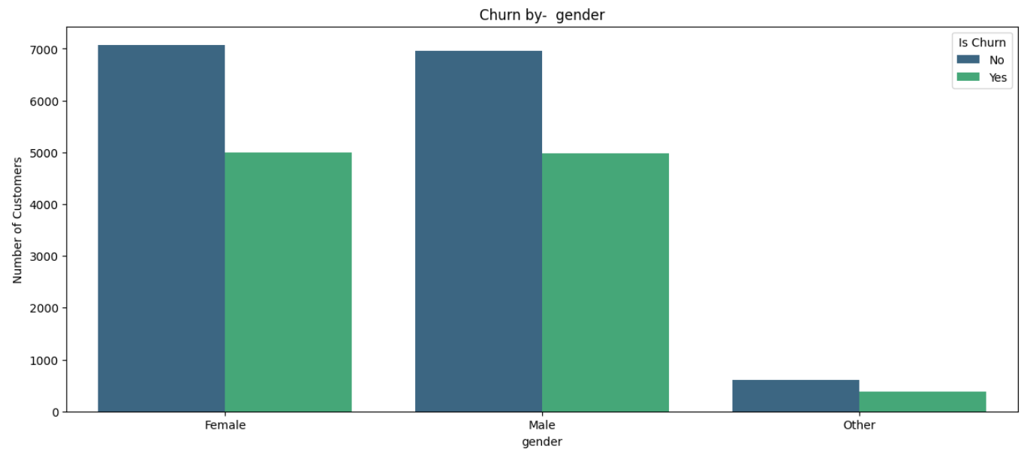
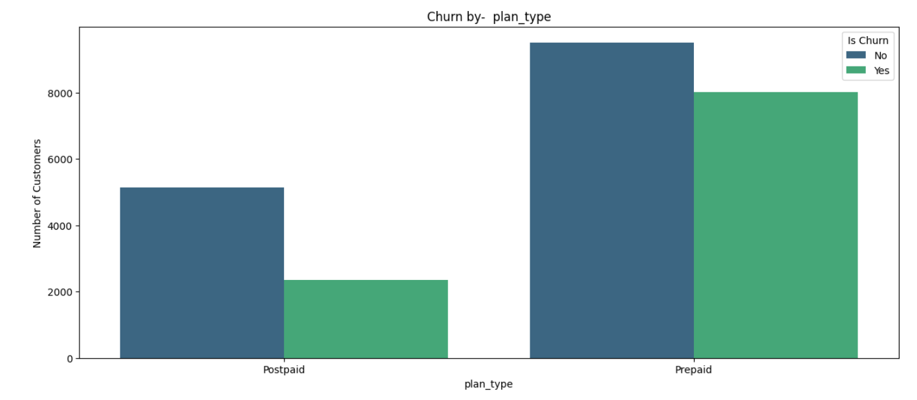
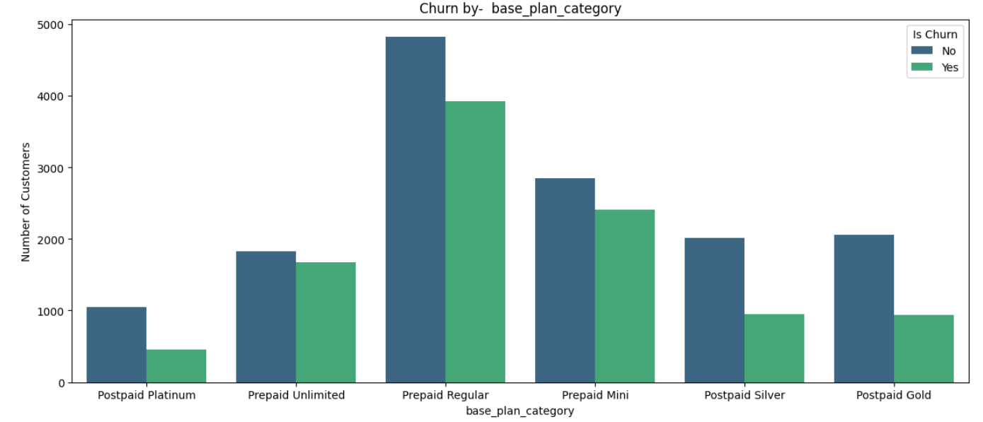
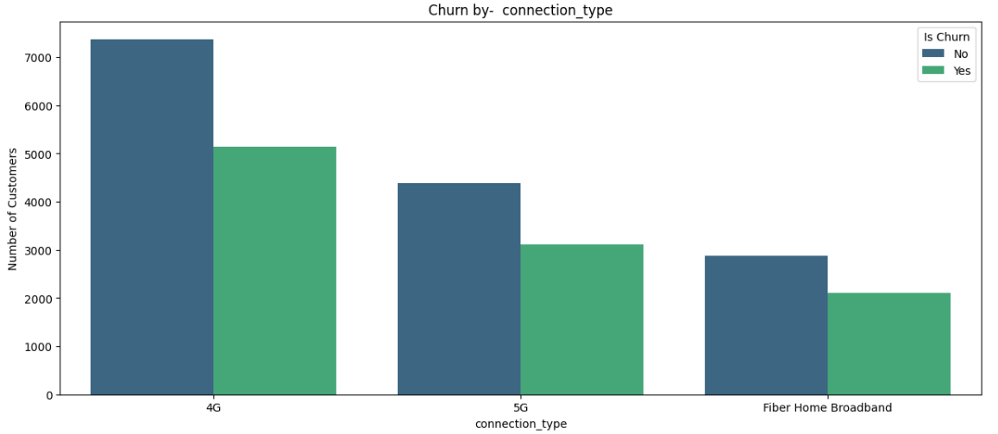

Slide 8
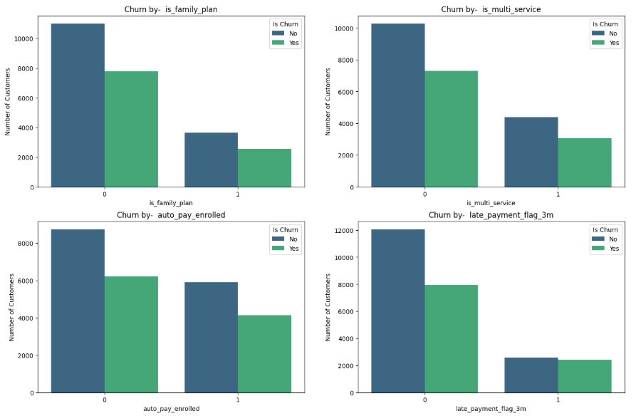

Slide 9
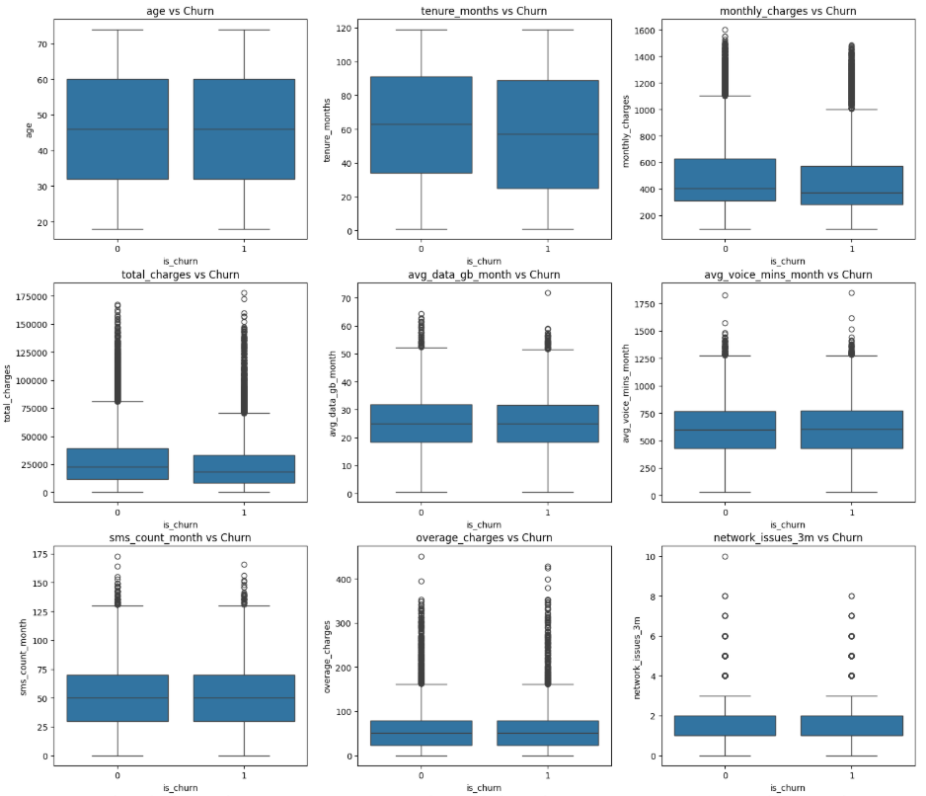

Slide 10
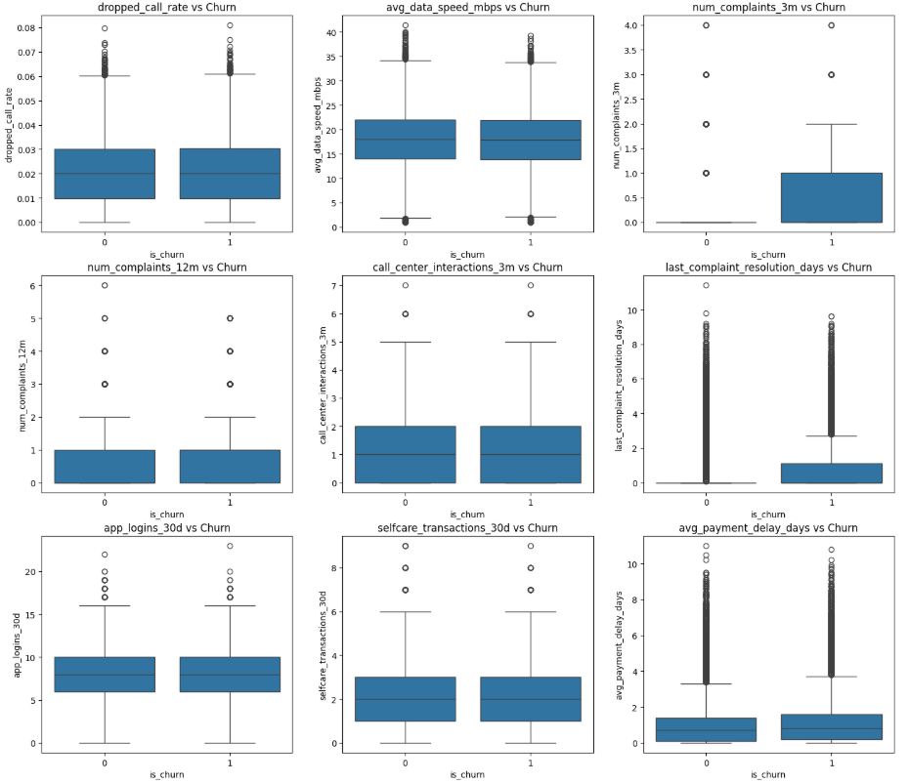

Slide 11
Key Insights from EDA
  High overage charges → higher churn probability
  Frequent complaints and call center interactions
→ churn risk
  Payment delays strongly associated with churn
  Service quality issues (low speed, dropped calls) impact churn

Slide 12
Feature Selection Decisions
  Dropped ‘monthly_charges’ due to high correlation with arpu
  Kept arpu as it reflects actual realized customer cost
  Dropped cumulative and leakage-prone features (monthly_charges', 'num_complaints_3m')
  Retained behavior-driven features impacting churn

Slide 13
Feature Engineering
  Created High Overage Risk Flag to capture billing shock behavior
  Engineered behavioral signals instead of raw extremes
  Focused on business meaning, not just statistical transformation

Slide 14
Outlier Handling Strategy
Data Preparation
  Did NOT blindly remove outliers
  Applied soft capping only where outliers likely represent noise:
    Billing spikes
    Measurement errors
  Preserved extreme values where they represent real churn behavior
  One-hot encoded categorical variables
  Feature scaling applied for Logistic Regression
  Stratified train-test split to maintain churn ratio

Slide 15
Models Used
Evaluation Metrics
  Logistic Regression (baseline & interpretable)
  Random Forest (non-linear, ensemble)
  XGBoost (gradient boosting)
  Purpose:
Compare simplicity vs
performance vs generalization
  ROC-AUC (primary metric – ranking churn risk)
  Precision, Recall, F1-score
  Train vs Test performance to detect overfitting

Slide 16
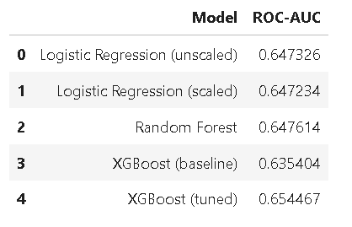
Model Performance

Slide 17
Model Performance Comparison
Why XGBoost Performed Best
  Logistic Regression: stable but limited non-linear learning
  Random Forest: better than LR, moderate generalization
  XGBoost: highest CV and test ROC-AUC
XGBoost performed best in ranking high-risk churn customers
  Captures non-linear churn behavior
  Learns feature interactions automatically
  Focuses on hard-to-predict churn cases
  Handles mixed feature types and imbalance effectively

Slide 18
Final Model Selection
Business Impact
  Selected XGBoost as primary model
  Logistic Regression retained as interpretable baseline
  Acknowledged mild overfitting and discussed regularization improvements
  Customers ranked by churn probability
  Enables targeted retention campaigns
  Improves marketing efficiency
  Reduces revenue leakage due to churn

Slide 19

Conclusion
  Built an end-to-end churn prediction pipeline
  Combined business understanding with ML modeling
  Delivered a practical, deployable churn scoring solution

